Slide 1
Hotel Booking Demand
IST 652
Group 11: Zeyang Zhou, He Pang, Xiaoben Yin, Jinlong Zhou

Slide 2
project introduction

Slide 3
Descriptive Analysis
Count
Mean
Standard Deviation
Quartile
Max & Mean
Basic Visualization

Slide 4
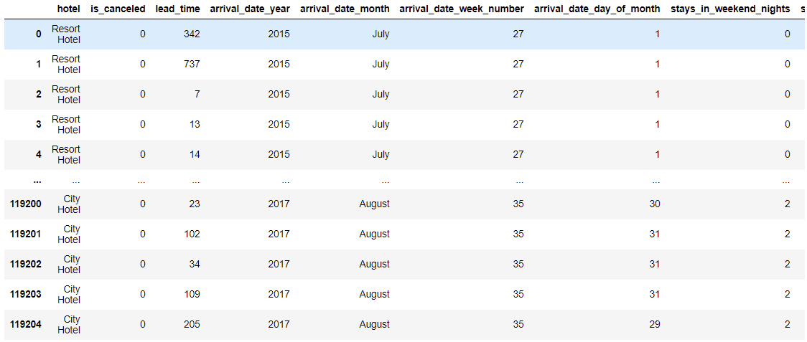
Data Overview
Hotel booking dataset is contains 119205 rows with 31 columns.

Slide 5
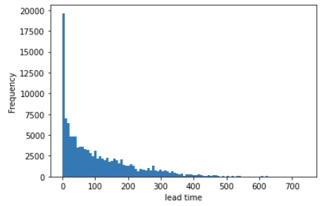
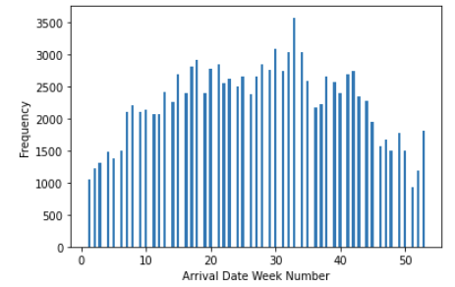
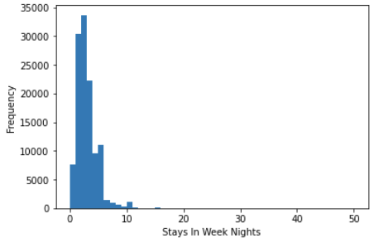
Normal varibales:
Lead Time
Arrival Date Week Number
Stays in Weekend Nights

Slide 6
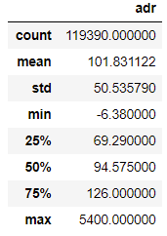
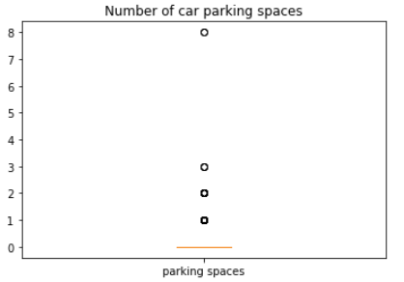
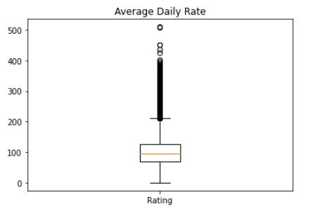
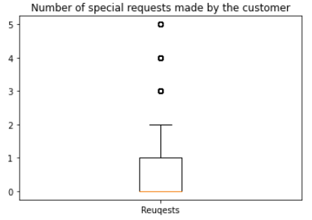
Abnormal variables:
Average Daily Rate
Number of Car Parking Spaces Required by the Customer
Number of Special Requests Made by the Customer

Slide 7
Data Cleaning
Cleaning and Preparation
Missing data
Data type
Duplicates
Outlier
Replacing values

Slide 8
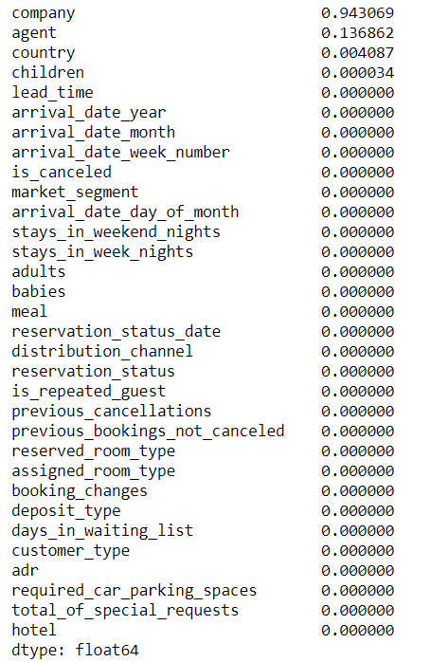
Missing Value Processing
company: 94.31%
agent: 13.69%
children: 0.0034%
country: 0.41%
Notes:
The missing values ​​of the data mainly exist in the four fields children, country, agent, company, and the most missing value is company
First, 4 children are missing and are numeric variables, so fill in with the median
Second, the country is missing 488 and is a categorical variable, so use the mode to fill in
Third, the agent is missing 16,340, the missing rate is 13.6%, and the number of missing is large, but the agent represents the travel agency booked, and the missing rate is less than 20%, it is recommended to keep it and fill it with 0, which means there is no travel agency ID
Fourth, the company is missing 112593, the missing rate is 94.3%>80%, and it does not have the validity of the information value, so it is deleted directly

Slide 9
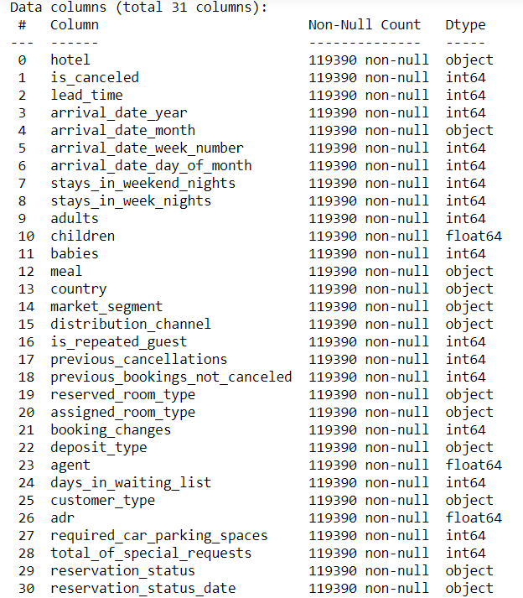
Data Type
Children: float64 ------->
Children: int64
travel agency: float64 ------->
travel agency: int64
(2.5 children or agent id: 304.5)
Notes:
It can be seen that the data type of children and travel agency agents cannot be floating, and they need to be changed as integer data.

Slide 10
Duplicates and Replacing
Type of meal booked. Categories are presented in standard hospitality meal packages:
Undefined/SC – no meal package; Undefined-------->SC
BB – Bed & Breakfast;
HB – Half board (breakfast and one other meal – usually dinner);
FB – Full board (breakfast, lunch and dinner)
“Since this is hotel real data, all data elements pertaining hotel or customer identification were deleted.” (Hotel booking demand datasets, 2019)
No primary key and duplicate values are allowed in this case
Notes:
Replacing: there are 5 types of meals in meal, among with which Undefined / SC-no meal set meal is one type, which needs to be replaced with SC type uniformly
We skip this step because there is no primary key existed in the dataset which means duplicate data are allowed in this case.

Slide 11
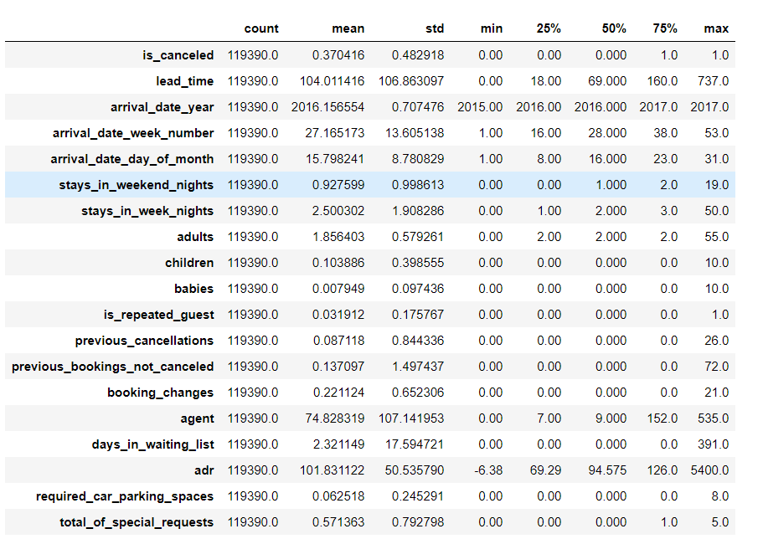

Outlier Handling
average daily charge of the hotel>5000
average daily charge of the hotel<0
adults+children+babies>0
adults or children or babies > 9
Notes:
The adults, children, and babies fields in the data set are all 0, that is, under the same order, the number of people who booked the stay cannot be 0, and needs to be removed.
The average daily charge of the hotel has an outlier value greater than 5000, which will seriously affect the descriptive statistics. The outlier value needs to be deleted

Slide 12
Visualization
Cancellation Situation & Monthly Cancellation rate
Busiest months for hotel
Country wise comparison
How long do people stay?
Correlation
Notes:
Now let’s move onto the visualization part.

Slide 13
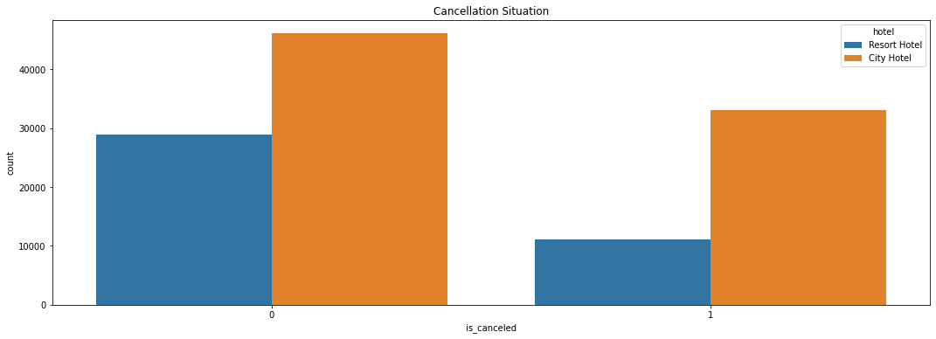
Visualization - Cancellation Situation
Notes:
The total cancellation rate is 37%, not canceled rate is 63%. The city hotel’s cancellation rate and not cancelled rate are both higher than that of resort hotel.

Slide 14
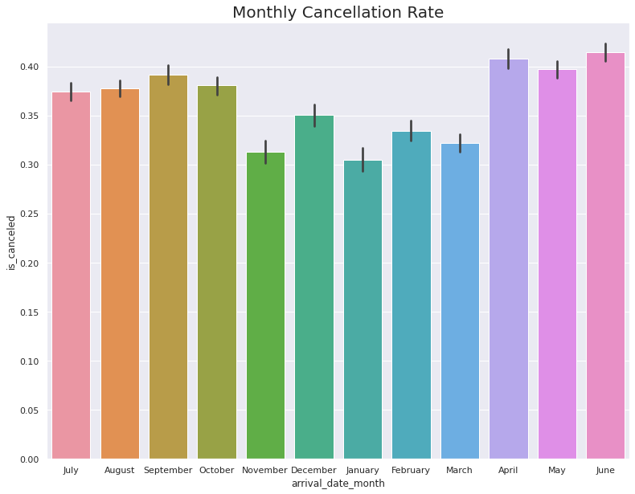
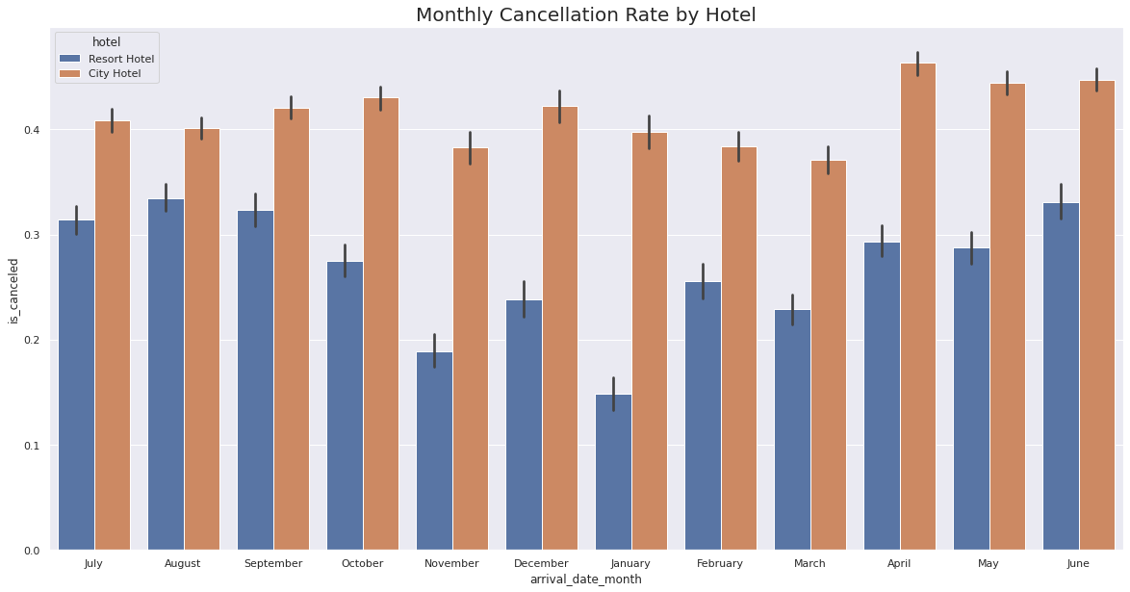
Visualization - Monthly cancellation rate
Notes:
The cancellation rates of city hotels are almost equal to other months even in winter, but the cancellation rates of resort hotel in winter are apparently lower than in summer months. The fact that the total cancellation rates of the winter months are low is that the cancellation rates of the resort hotels are low in these months. In short, the possibility of cancellation of resort hotels in winter is very low.

Slide 15
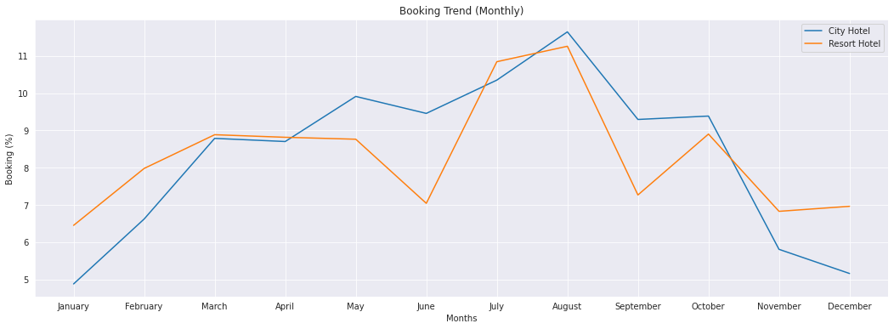
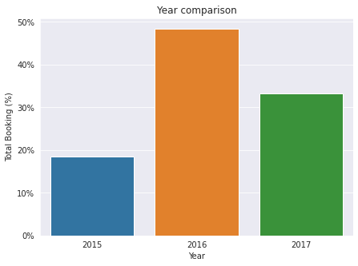
Visualization - Busiest months for hotel
Notes:
We can see the busiest booking months are from July to August, and the least bookings were made at the start and the end of the year. Besides, resort hotels have more bookings at the start and the end of the year compared to city hotels. And the resort hotel has apparently lower bookings in June and September compared to other months in summer.

Slide 16
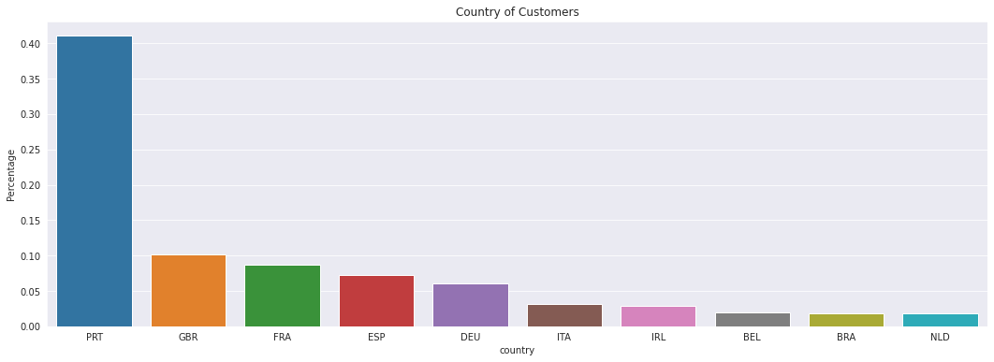
Visualization - Country wise comparison
Notes:
For the country wise comparison, Portugal, UK and France, Spain and Germany are the top countries from most guests come, more than 80% come from these 5 countries.

Slide 17
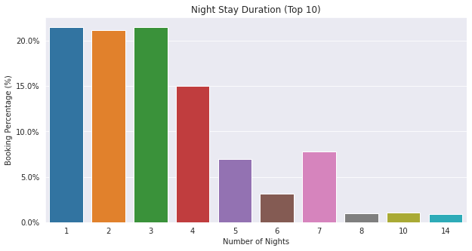
Visualization - How long do people stay?
Notes:
We also create a bar graph for how many days people usually stay. Most people stay for one night, two, or three nights and more than 60% of guests come under these three options.

Slide 18
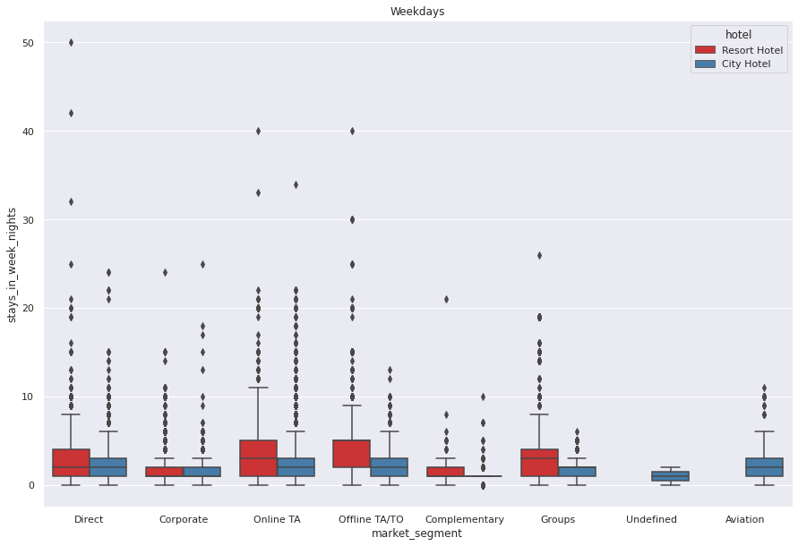
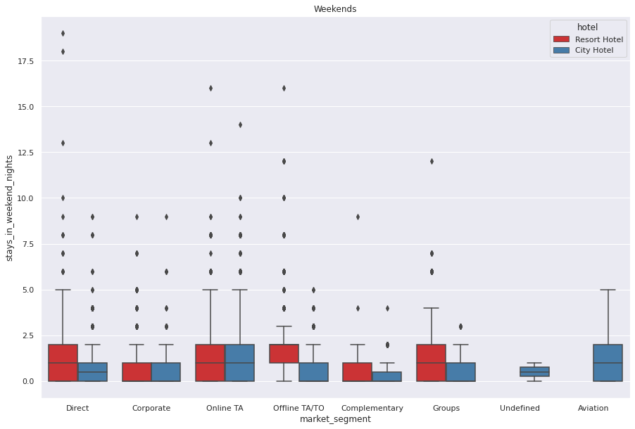
Visualization - How long do people stay?
Notes:
It can be seen that most of the groups are normal distributed, some of them have high skewness. Looking at the distribution, most people do not seem to prefer to stay at the hotel for more than 1 week. But it seems normal to stay in resort hotels for up to 12-13 days. As it turns out, customers from Aviation Segment do not seem to be staying at the resort hotels and have a relatively lower day average. Apart from that, the weekends and weekdays averages are roughly equal. Customers in the Aviation Segment are likely to arrive shortly due to business. Also probably most airports are a bit away from sea and its most likely to be closer to city hotels.

Slide 19
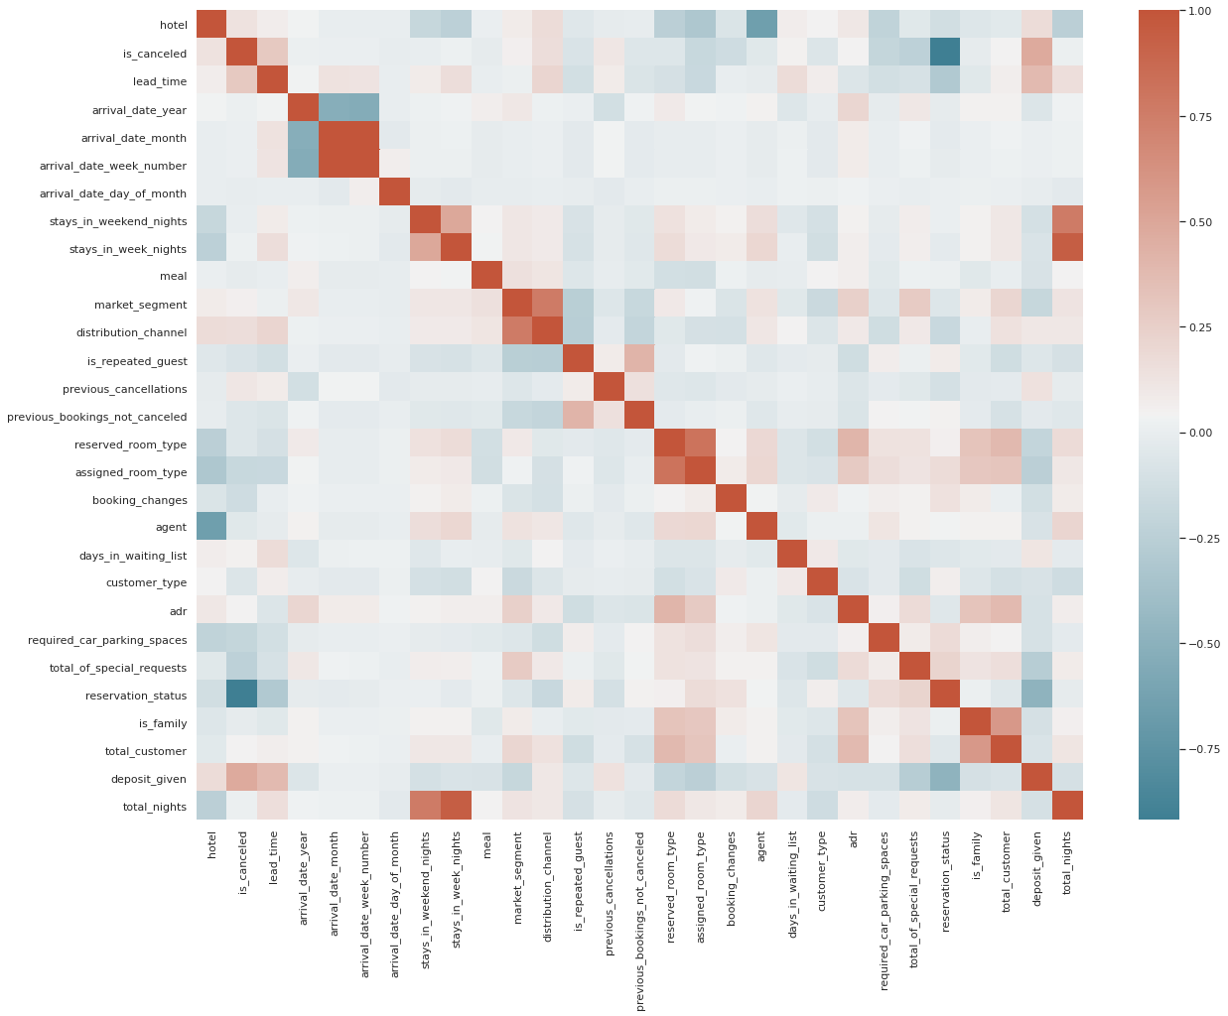
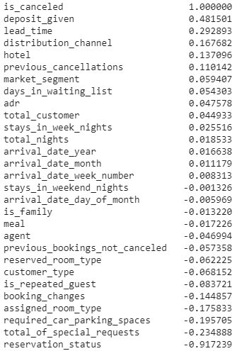
Visualization - Correlation
Notes:
We made a correlation heatmap on the left, and the list on the right shows the correlation scores. From the result, we can see that the most correlative variables are whether or not the deposit is given and whether the booking is canceled or not. The following factors are lead time, distribution channel, hotel type and previous cancellations situation, which accounts for approximately 20% or 10%.

Slide 20
questions?

